Slide 1

Big Mountain Resort Presentation
Armand Punjabi
May 25th 2022

Slide 2
Problem Identification
Big Mountain wants to select a better value for its ticket price
Current Adult Weekend ticket price is $81
Suspicion is that Big Mountain is not capitalizing on its facilities as much as it could be
How can Big Mountain find a ticket price that supports its facilities?

Slide 3
Problem Identification (cont.)
Big Mountain has recently installed a new chair lift, which has increased its operating costs by $1.54M for this upcoming season
What other strategic changes can Big Mountain make to optimize its facilities and cover the cost of the new chair lift?

Slide 4
Recommendations
Big Mountain can justify an increase in its ticket price up to $95.87
Big Mountain’s facilities compare well to those in its market, and can thus charge a premium for them
Big Mountain can also increase its revenue by an estimated $3.47M per year
This can be done by adding an additional Run, increasing the Vertical Drop by 150 ft., and installing an additional chair lift

Slide 5
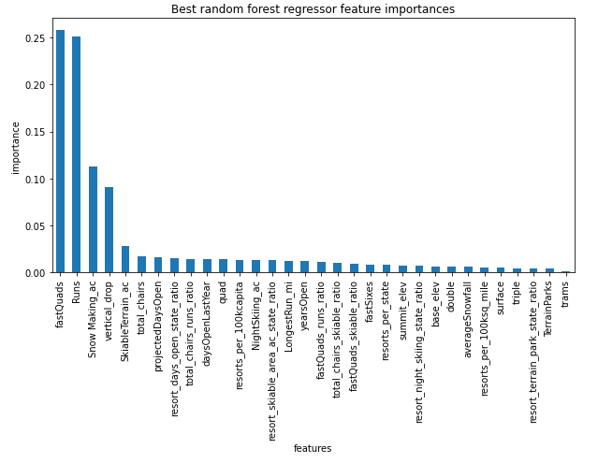
Analysis
A random forest model was selected to predict the price for an Adult Weekend ticket
The GridSearchCV function was applied to this model in order to find out which features were the most influential in predicting price
4 of the most impactful features were:
Fast Quads
Total Runs
Snow Making
Vertical Drop

Slide 6
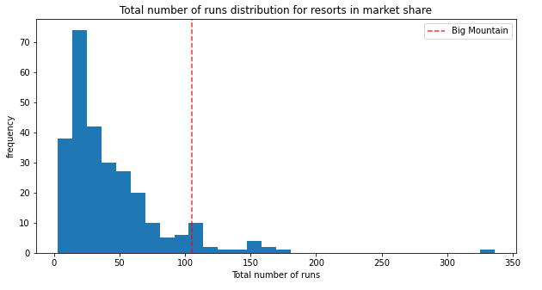
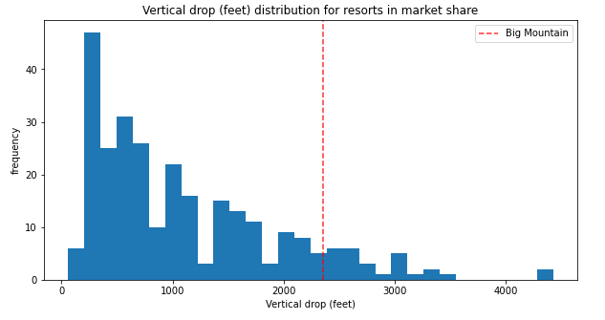
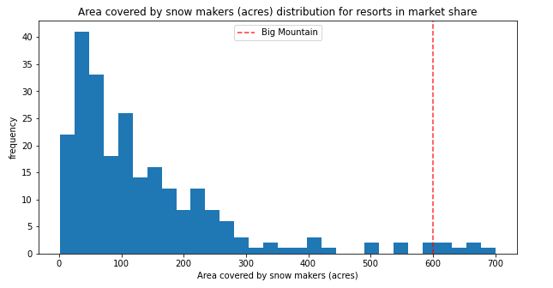
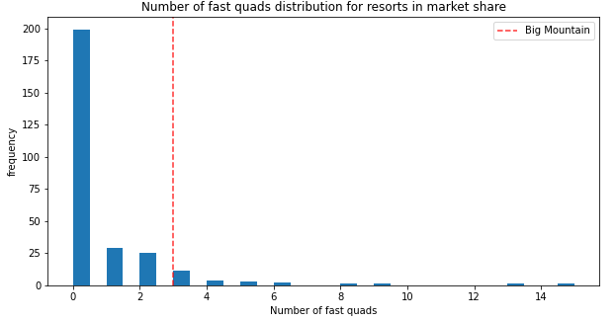
Analysis (cont.)
Big Mountain is well positioned in all 4 of these features, thus justifying a price increase

Slide 7
Analysis (cont.)
Further analysis showed that Big Mountain has the opportunity to increase revenue by an estimated $3.47M per year
This scenario was input to the random forest model
Add 1 run
Add 1 lift
Increase vertical drop by 150ft
This would support a $1.99 increase in ticket price
Assuming 350k visitors staying an average of 5 nights, this would equal $3,473,683 in additional revenue

Slide 8
Conclusion
Big Mountain can increase its ticket price based on the price prediction from the random forest regression model
This price increase will optimize 4 of its most important facilities, which are well positioned within the ski resort market
Big Mountain can also explore the opportunity to generate more revenue by adding a run, increasing the vertical drop by 150 ft., and adding an additional ski lift
This change combined with the price increase will generate extra revenue for Big Mountain, and allow it to make better data driven decisions moving forward

